Slide 1
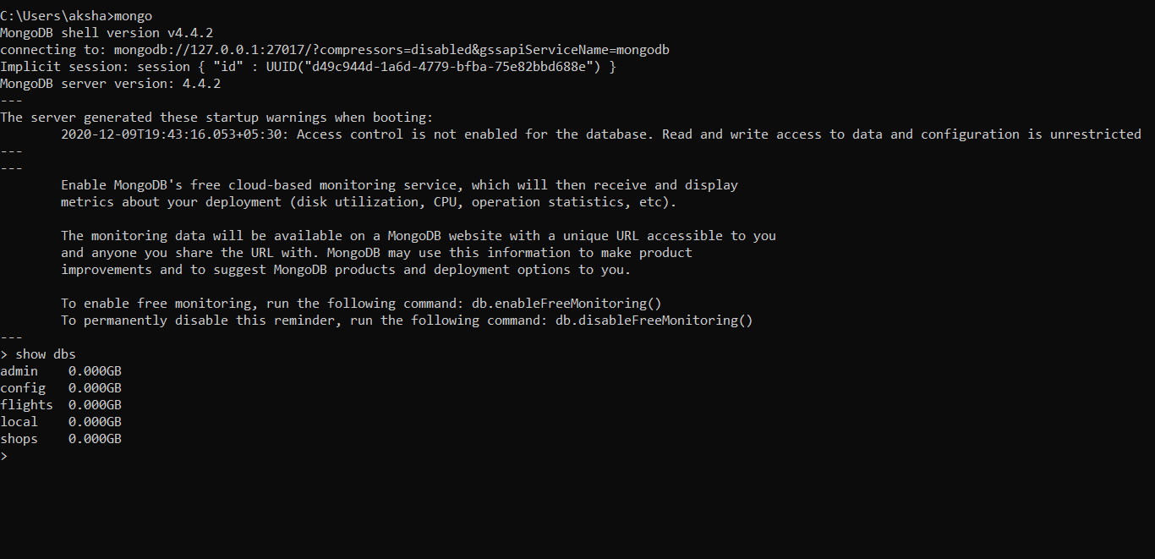
CRUD OPERATIONS

Slide 2
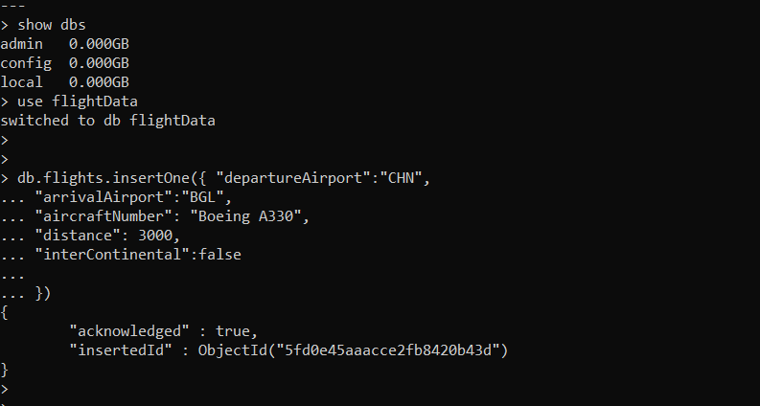
CREATE - insertOne()

Slide 3
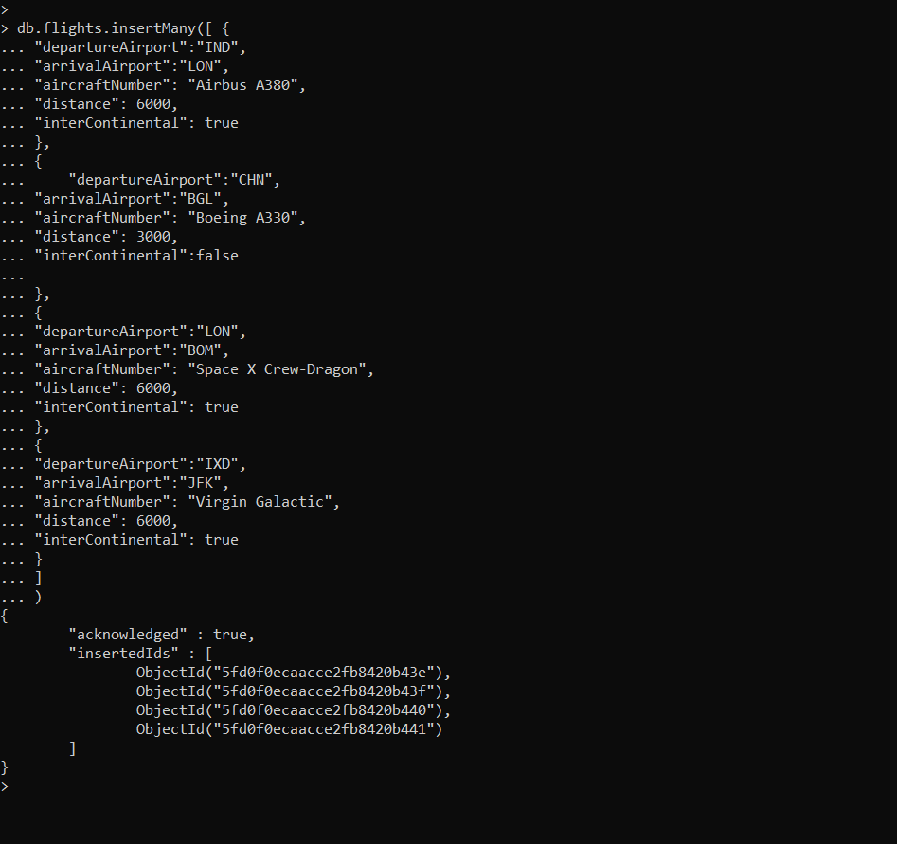
InsertMany()

Slide 4
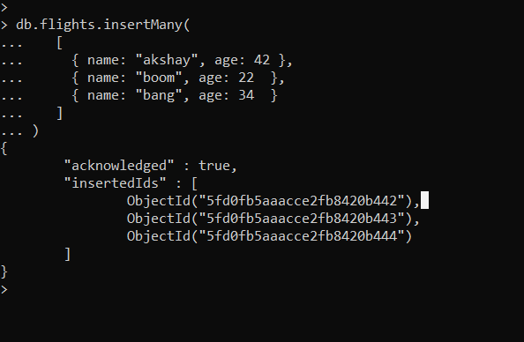
Inserting Array of Objects.

Slide 5
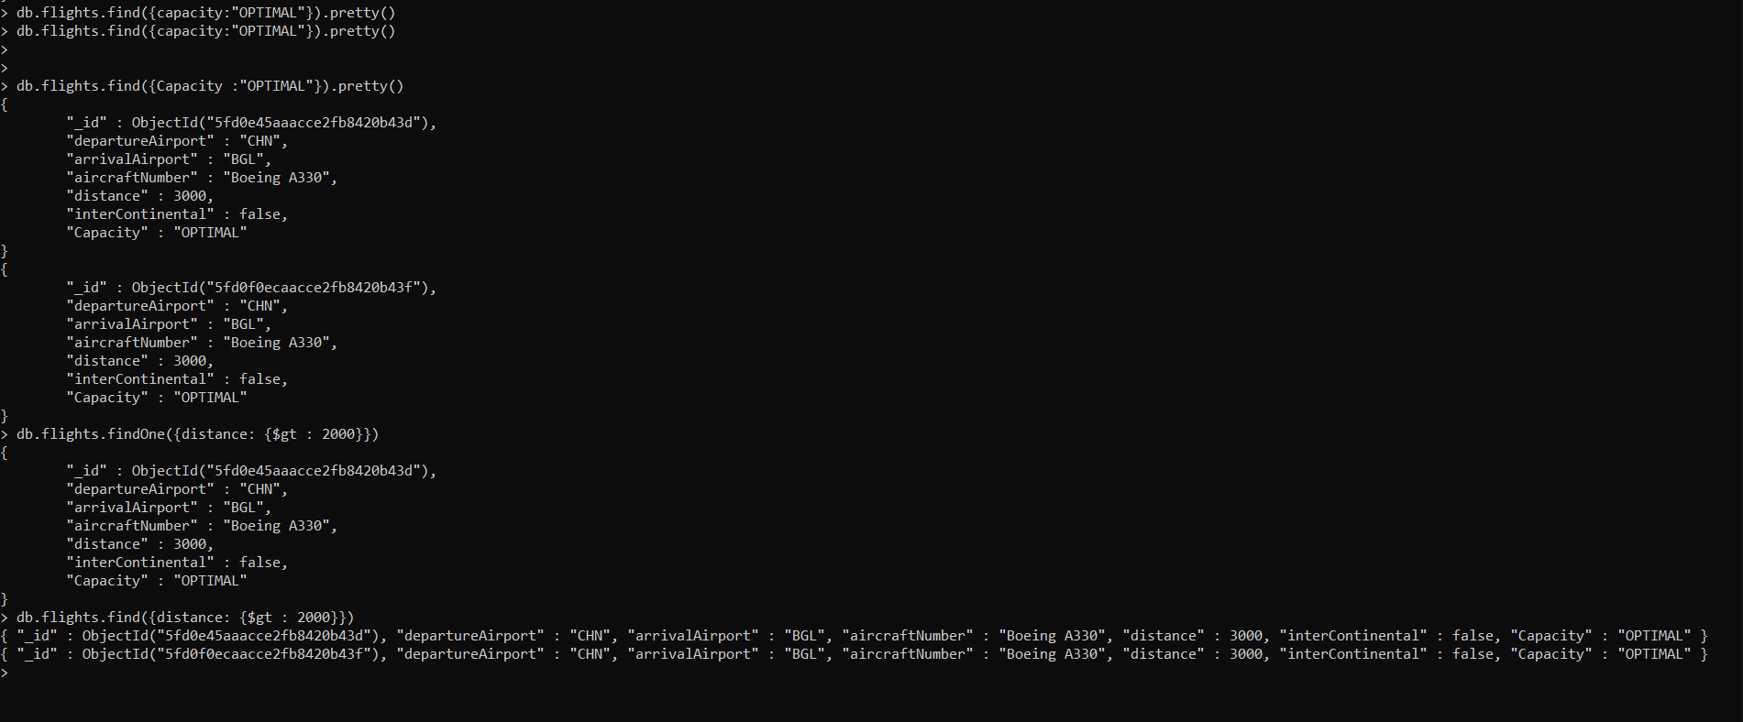
READ - find()

Slide 6
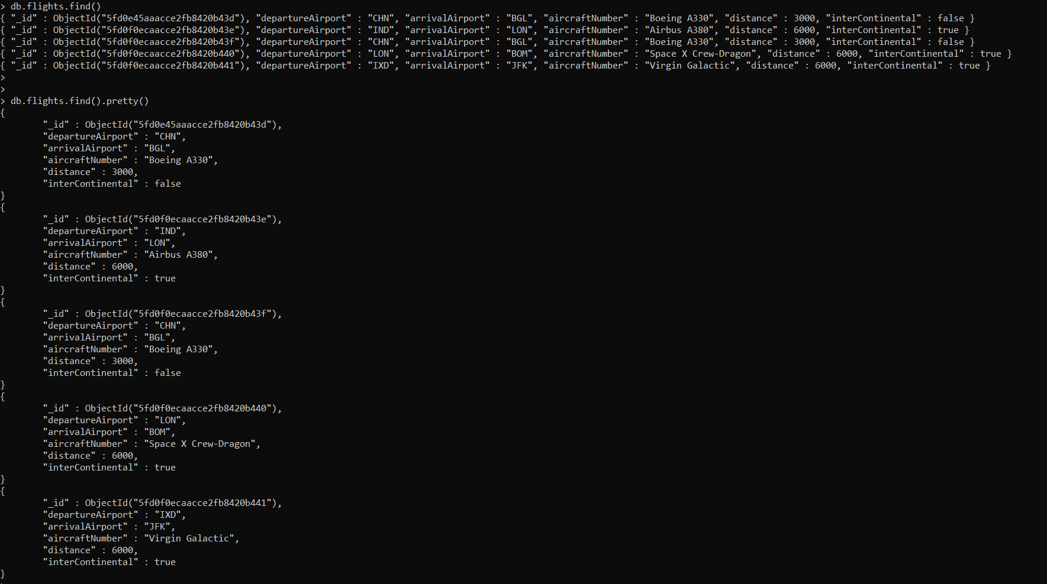
Pretty( )

Slide 7
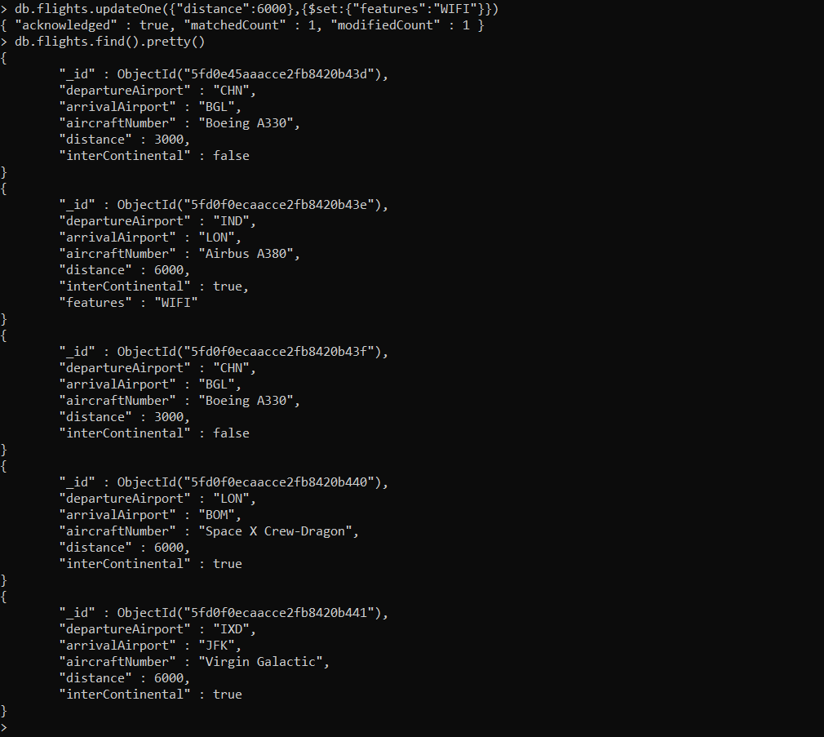
UPDATE - updateone()

Slide 8
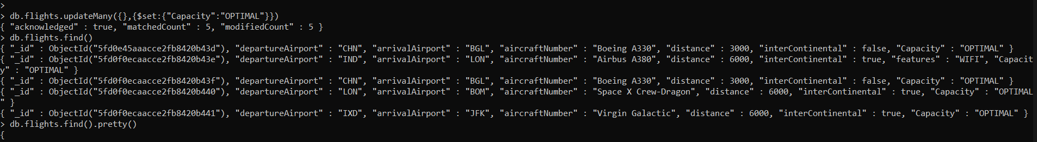
updateMany()

Slide 9
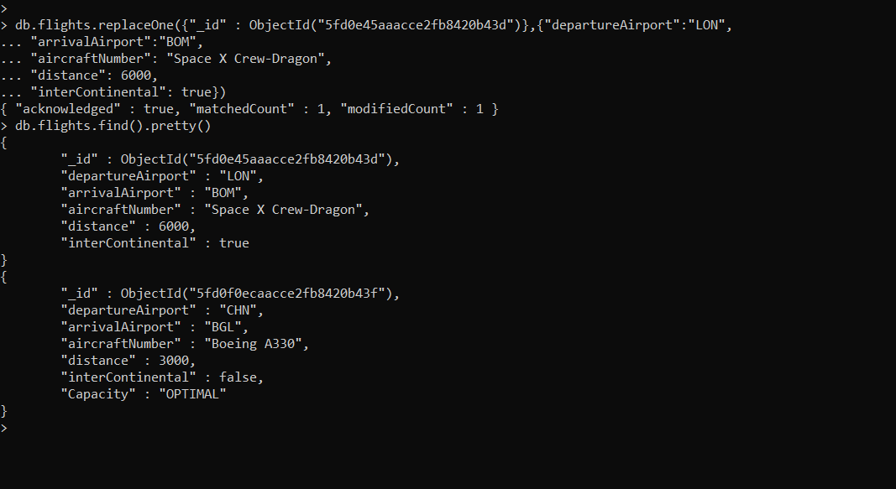
replaceOne()

Slide 10
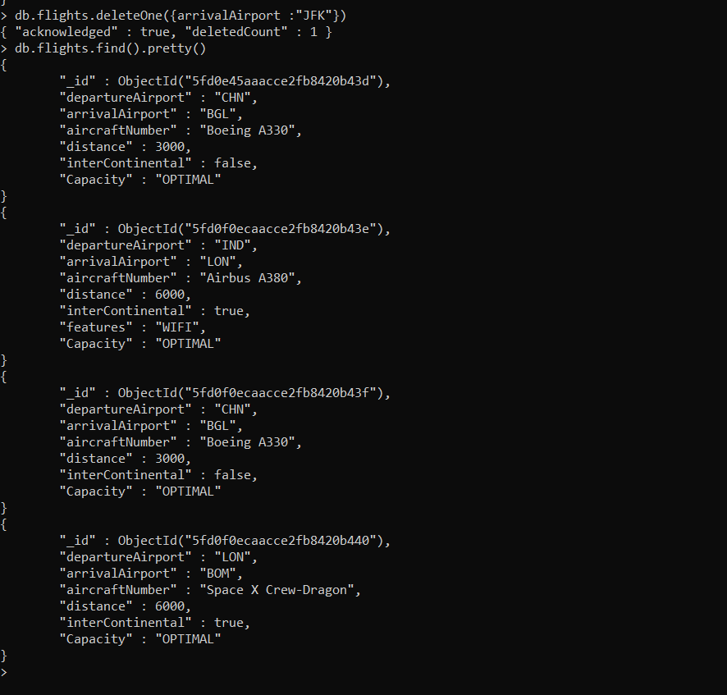
DELETE-deleteOne()

Slide 11
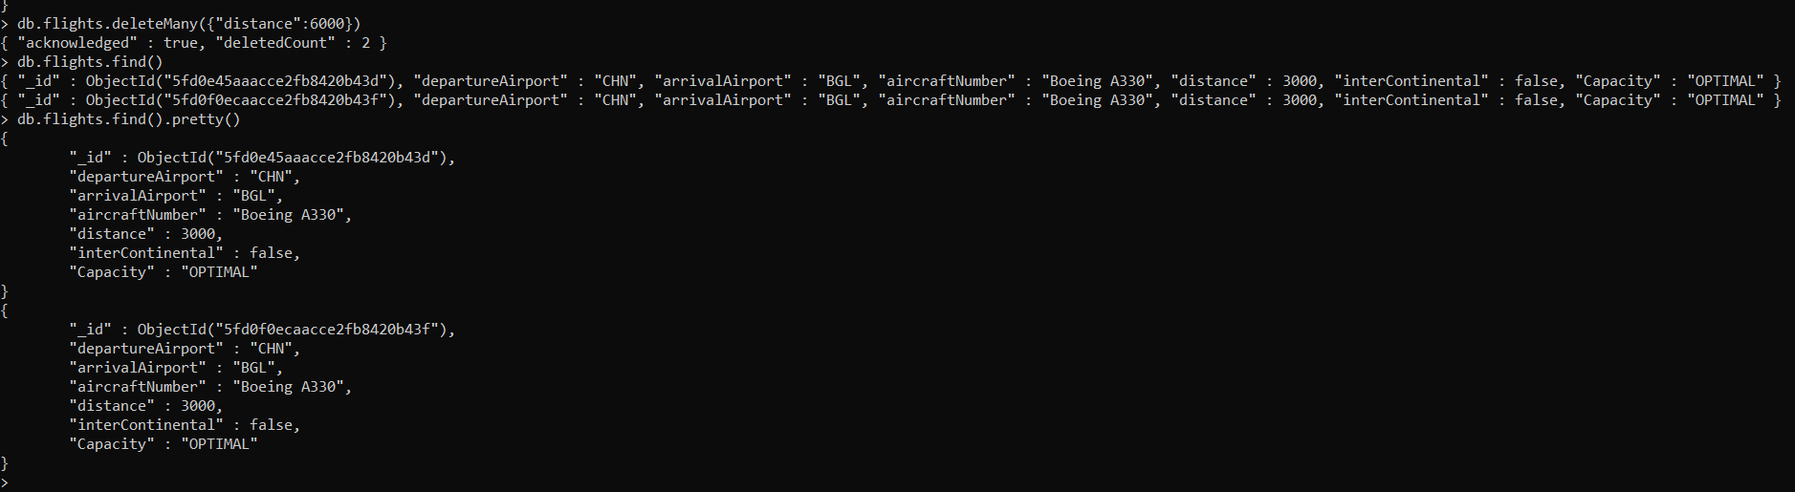
- deleteMany()

